Slide 1
Keyloggers & Anti-keyloggers
REVIEW-1
Slot: A2+TA2
Submitted to :- CHANDRA MOHAN B

Slide 2
Team Members
Tushar Tewari :- 17BCE0122
Ricky Sabharwal :- 17BCE0159
Sambhav Bhayana :- 17BCE0873
Chinmay Soni :- 17BCE0578
Sumit Vaish :- 17BCE0753
Vansh Arora:- 17BCE0857

Slide 3
Abstract
It is likely that about one out of many large companies systematically monitors the computer, internet, or email use of its users employees.
There are over hundred’s different products available today that will let organizations see what their users do at work on their "personal" computers, in their email, and on the internet.
keylogger (keystroke logging) is a type of surveillance software that once installed on a system, has the capability to record every keystroke made on that system.
The recording is saved in a log file, usually encrypted.

Slide 4
In this project we will make a keylogger which will be able to record all the keystrokes and gain all the information that is typed using a keyboard by the person.
By this we will be able to monitor all the things that a person is using or surfing on his laptop.
Since the keyloggers can also be used to steal information(can be in form of malware) , we will build a Anti-keylogger that will be able to detect whether there is a keylogger installed or running on the system.
By making an anti-keylogger we will be able to monitor the information on our system is not been shared by anyone .

Slide 5
Working of the model
Keyloggers
In Keyloggers, the input will be all the keystrokes(all the keys pressed from the keyboard).
Once the user type a key from his/her keyboard, the keylogger program running on the background will start executing.
It will check the ASCII value of all the keys that are pressed and if ASCII==5 , the program will exit.
If ASCII is not equal to 5 , then the program will check for the letter which has the ASCII equal to that provided with event.

Slide 6
After this , the alphabet or the special character will be written in the output file .
The code will be creating a hook Manager object and set it for the key strokes and info to follow.
After this, The keylogger will be started in the background and save all the data on the log file as output file.

Slide 7
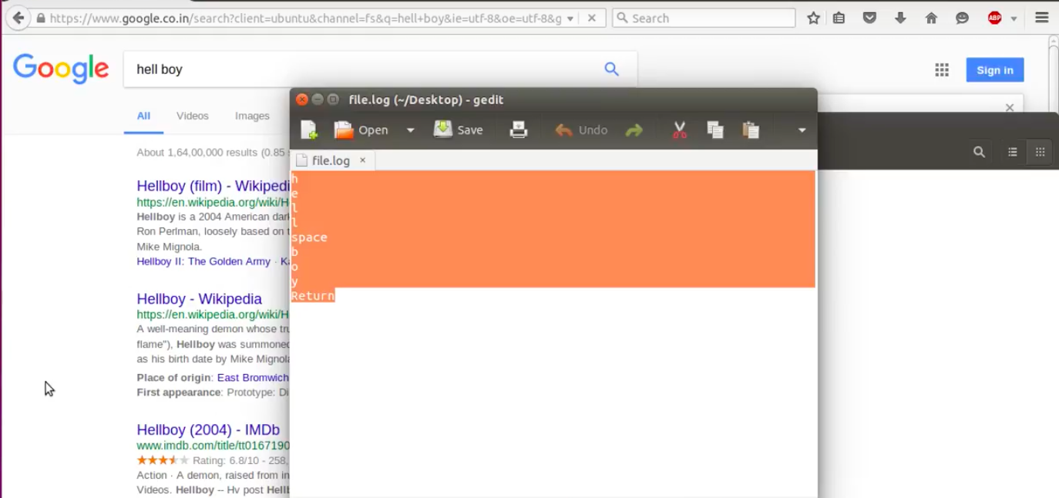
In this way we will search the web and we will get that written on our log file

Slide 8
Anti-Keyloggers
Anti-keyloggers , are used so that no one gain access to the information that a person is typing
In this part of project , we will create a type of environment or will try to detect if there is a Keylogger in the system of the user.
By this the information of the user will not be shared with any other person.
Once the user type the code , he/she will be able to create a desktop which will not be accessible to any keylogger.

Slide 9
This is possible by the means of using different kernel which is not seen by the keylogger program .
Once the work of anti-keylogger is finish it will close the secure desktop which is not needed now.
Basically, the 2 desktops are separated by the kernel, so the applications can't interact: the keylogger that is running on the original desktop will not intercept the messages received by a program which is found on the other desktop.

Slide 10
Conclusions
As a result , we will be creating 2 things keylogger and an anti–keylogger to detect them .
The keylogger will be able to read all the information whereas typing after anti-keylogger will create a new thread that will not be able to read or detect the information.
As a result , the information will be safe and no one except the user will be able to read this.

Slide 11
References
https://en.wikipedia.org/wiki/Keystroke_logging
https://www.webopedia.com/TERM/K/keylogger.html
https://en.m.wikipedia.org/wiki/Anti-keylogger?wprov=sfla1
https://securelist.com/keyloggers-how-they-work-and-how-to-detect-them-part-1/36138/
http://ijarcet.org/wp-content/uploads/IJARCET-VOL-4-ISSUE-4-1465-1469.pdf

